Slide 1


Arrangement and Description:
Fundamentals
Pam Hackbart-Dean
Susan Potts McDonald
Day 2: Description
©2016 Society of American Archivists

Slide 2

Descriptive Standards
Data structure [fields/elements]
Bibliographic records
Encoded finding aids

Slide 3
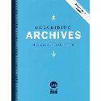

Descriptive Standards
Data content [rules]
Describing Archives:
A Content Standard (DACS)
Resource Description & Access (RDA)

Slide 4
Descriptive Standards
Data structure [terms]
Bibliographic records
Encoded finding aids

Slide 5



Descriptive Standards
Data value [vocabularies]
Library of Congress Name Authorities
Library of Congress Subject Headings
Art and Architecture Thesaurus

Slide 6

SAA Standards Portal
Standards adopted by SAA
Standards external to SAA
standards
guidelines
best practice documents

Slide 7
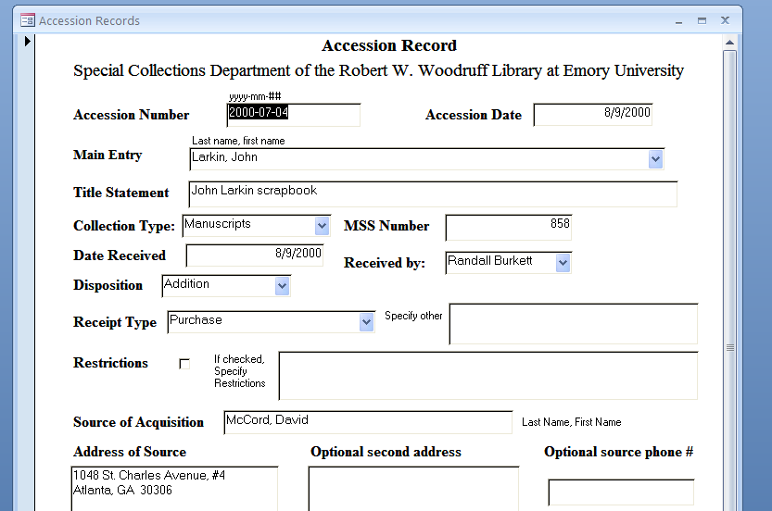
Accessioning
Legal transfer collections
Manuscript numbers and Manuscript registers
Accession records
Collection file
Shelf list

Slide 8
Manuscript Register
MSS Number | Origination (creator) | Title Statement
1 | Candler, Asa Griggs | Asa Griggs Candler papers
2 | Candler, Warren A. (Warren Akin), 1857-1941 | Warren A. Candler papers
3 | Candler, Charles Howard, 1878-1957 | Charles Howard Candler papers
4 | Candler family | Candler family collection
5 | Harris, Joel Chandler | Joel Chandler Harris papers
6 | Harris, Julian LaRose, 1874-1963 | Julian LaRose Harris papers
7 | Harrold Brothers (Firm : Americus, Ga.) | Harrold Brothers records
8 | Herty, Charles H. (Charles Holmes), 1867-1938 | Charles H. Herty papers
9 | Palmer, Charles F. (Charles Forrest), 1892-1973 | Charles F. Palmer papers
10 | Woodruff, Robert Winship | Robert Winship Woodruff papers
11 | Allen, Young John, 1836-1907 | Young John Allen papers
12 | Ash, John H., d. 1918 | John H. Ash papers
13 | Barnsley, Godfrey, 1805-1873 | Godfrey Barnsley family papers
14 | Beauregard, G. T. (Gustave Toutant), 1818-1893 | G.T. Beauregard papers
15 | Great Britain. Consulate (Savannah, Ga.) | Great Britain, Consulate (Savannah, Ga.) papers
16 | Brown, Joseph E. (Joseph Emerson), 1821-1894 | Joseph E. Brown papers
17 | Charleston Harbor | Charleston Harbor documents

Slide 9
Accession Record
Accession No.: 2015-07-04 | Accession Date: 7/9/2015
Origination: Larkin, John
Title Statement: John Larkin scrapbook
Collection Type: Manuscript | Manuscript No: 858
Date Received: 7/9/2015 | Received by: Randall Burkett
Receipt type: Purchase
Restrictions: None
Source of Acquisition: McCord, David
Address of Source: 2222 Two Street, Atlanta, GA 30322 | Phone: 222-222-2222
Provenance: Collection was purchased from dealer, provenance unknown
Extent: 1 volume
Location: xxx
Description: Scrapbook containing newspapers clippings, broadsides, and other ephemera relating to African American vaudeville performer and screen actor, John Larkin from ca. 1914-1932.
Acknowledged by: Terry Eggplant | Date: 7/11/2015

Slide 10
Shelf List
ORIGINATION | TITLE | MSS | LOCATION | L.F. | BOXES | OP | BV | OBV | MF | NOTES
Abbey Theatre | Abbey Theatre collection | 244 | xxx | 4.00 | 8
Abram, Morris B. | Morris B. Abram papers | 514 | xxx | 96.00 | 96
Abse, Dannie | Dannie Abse collection | 999 | xxx | 0.50 | 1
Adams, Julia | Julia Adams scrapbooks | 136 |  |  |  |  |  |  | 2
Adams, Lawrence L. | Lawrence L. Adams collection | 963 |  |  |  |  |  |  |  | Transferred to Georgia State University Special Collections, Sept. 4, 2003
Adams, Oscar W. | Oscar W. Adams papers | 931 | xxx | 4.00 | 8 |  |  |  |  | IN PROCESS: RANDY GUE and TEAM
Adams, W. H. | W. H. Adams reminiscences | 465 |  |  |  |  |  |  | 1
African American cinema collection | African American cinema collection | 814 | xxx | 8.00 | 17
African American miscellany | African American miscellany | 1032 | xxx | 0.25 | 1 |  | 1 | 2

Slide 11
DACS
Guiding Principles
The Nature of Archival Holdings
1: Records in archives possess unique characteristics.
2: The principle of respect des fonds is the basis of archival arrangement and description.

Slide 12
DACS
Guiding Principles
The Relationship between Arrangement and Description
3: Arrangement involves the identification of groupings within the material.
4: Description reflects arrangement.

Slide 13
DACS
Guiding Principles
The Nature of Archival Description
5: The rules of description apply to all archival materials, regardless of form or medium.
6: The principles of archival description apply equally to records created by corporate bodies, individuals, or families.

Slide 14
DACS
Guiding Principles
7: Archival descriptions may be presented at varying levels of detail to produce a variety of outputs.
  7.1: Levels of description correspond to levels of arrangement.
  7.2: Relationships between levels of description must be clearly indicated.
  7.3: Information provided at each level of description must be appropriate to that level.

Slide 15
DACS
Guiding Principles
The Creators of Archival Material
8: The creators of archival materials, as well as the materials themselves, must be described.

Slide 16
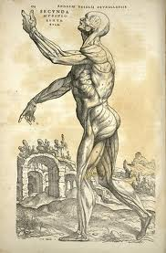
Anatomy of a Finding Aid
Descriptive Summary
Administrative Information
Collection Description
Container list / Description of Series

Slide 17
Descriptive Summary
Origination
Title Statement
Dates
Physical Description
Language

Slide 18
Administrative Information
Conditions Governing Access
Conditions Governing Use
Alternate Form Available
Location of Originals
Bibliography
Related Materials
Separated Materials
Acquisition Information
Custodial History
Citation

Slide 19
Collection Description
Biography or History
Scope and Content Note
Arrangement
Other Finding Aid

Slide 20
Container List /
Description of Series
For collections with no series/subseries:
a listing of numbered boxes and folders along with a description of their contents.
For collections with series/subseries:
any applicable elements listed above followed by a listing of numbered boxes and folders along with a description of their contents

Slide 21
Selected Finding Aid Elements
MARC21 field name
EAD3 element name
 Cross reference to DACS
 Internet resource
Definition of element
Examples

Slide 22
Descriptive Summary

Slide 23

Origination (Creator)
Most commonly used:
Personal name
Corporate name
Meeting name

Slide 24
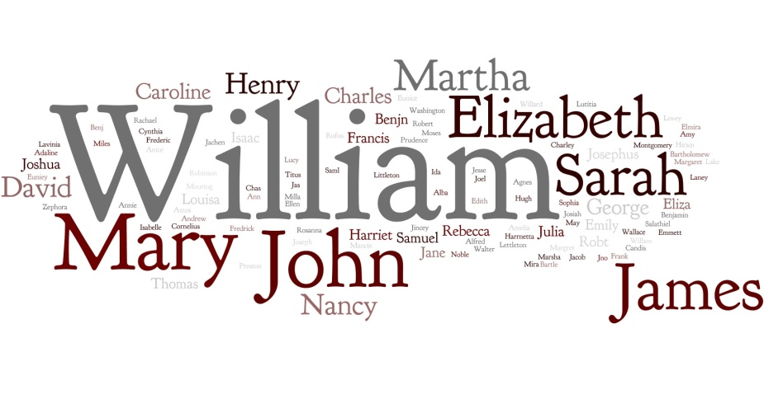
Origination - Personal name
Personal papers of an individual
Personal papers of two or more individuals
Family papers
Artificial collections
Entry under author

Slide 25
Personal name examples
Johnson, Herschel V. (Herschel Vespasian), 1812-1880.
Perceval, John, Earl, 1683-1748. [added title or terms of address]
Williams, Sherman, Mrs. [added title or terms of address]
Smith, George Leon, 1912-1973, collector. [added relator term]

Slide 26

Origination - Corporate name
Businesses
Organizations/Institutions
Government offices/officials
Legislative bodies
Constitutional conventions
Courts
Armed forces
Religious bodies
Exhibitions, fairs, festivals, etc.
Chapters, branches, etc.

Slide 27
Corporate name examples
United States. Congress. Senate.
South Dakota. Board of Dental Examiners.
Confederate States of America. Army. Georgia Infantry Regiment, 5th.
J. J. Smith and Company (Watkinsville, Ga.)
Cobb County School Board (Ga.)
Saint Stephens Church (Milledgeville, Ga.)
Sons of the American Revolution. Georgia Society.
WSB (Radio station : Atlanta, Ga.)

Slide 28
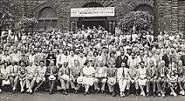
Origination - Meeting name
Conferences
  Conference on Aging (2nd : 1990 : Washington, D.C.)
Congress
  World Aviation Congress (1996 : Los Angeles, Calif.)
Meetings
  Cotton States Exposition
  (1895 : Atlanta, Ga.)

Slide 29
Origination (creator)
Usually only one creator to provide a primary access point by which the collection may be searched
Name of creator corresponds to the provenance or office of origin
The chain of custody, involving who held, received, or transferred the records, should not be confused with the original provenance when determining the creator
Origination (creator) is not a required element
Where there is no creator, the collection is described by the title statement

Slide 30
Guidelines for multiple origination
Personal papers
  Where there are two or more creators, choose the person that is more prominent, or whose papers predominate
  Organizational records
  Where there are multiple creators, choose the name of the most recent creator represented in the records

Slide 31
Title statement
Create a title that best describes the material in terms of the creator, type of materials, and subject.
records
papers
collection
family papers or families papers

Slide 32
Title statement examples
Sidney Lanier papers [individual]
John and Lugenia Burns Hope papers [papers of two individuals]
Georgia Historical Society records [organization]
Division of Fisheries administrative records
John J. Oglethorpe family papers [single family]
Gregory, Walker, and Bonifay families papers [multiple families]
W.B. Yeats collection [artificially created collection]

Slide 33
Descriptive title statements
John Stone Killens World War II diary
Ringling family photograph albums
South Carolina Society of Bird Watchers minutes
Civil rights oral history interviews

Slide 34
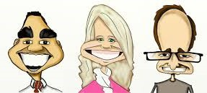
Origination (Creator) vs. Title:
Enter origination under personal name
➢ Personal papers of an individual
Creator: Pinckney, Charles, 1757-1824.
Title statement: Charles Pinckney papers

Slide 35
Origination (Creator) vs. Title:
Enter origination under personal name
➢ Personal papers of two or more individuals where one the persons can be considered more prominent, or one person’s papers are predominate
Creator: Hope, John, 1868-1936.
Title statement: John and Lugenia Burns Hope papers

Slide 36
Origination (Creator) vs. Title:
Enter origination under personal name
➢ Family papers formed around or generated by members of one family
Creator: Ward, John Elliot, 1814-1902.
Title statement: John Elliot Ward family papers

Slide 37
Origination (Creator) vs. Title:
Enter origination under personal name
➢ Artificial collections assembled by an individual
Creator: Fink, Gary M., collector.
Title statement: South Carolina governors collection

Slide 38
Origination (Creator) vs. Title:
Enter origination under personal name
➢ An individual manuscript, letter, diary, etc.
Creator: Cobb, Howell, 1795-1864.
Title statement: Letter to Thomas Reade Rootes Cobb, 1821 October 13

Slide 39
Origination (Creator) vs. Title:
Enter origination under a corporate name
➢ The corporate records of a single corporate body
Creator: Charleston Bible Society.
Title statement: Charleston Bible Society records

Slide 40

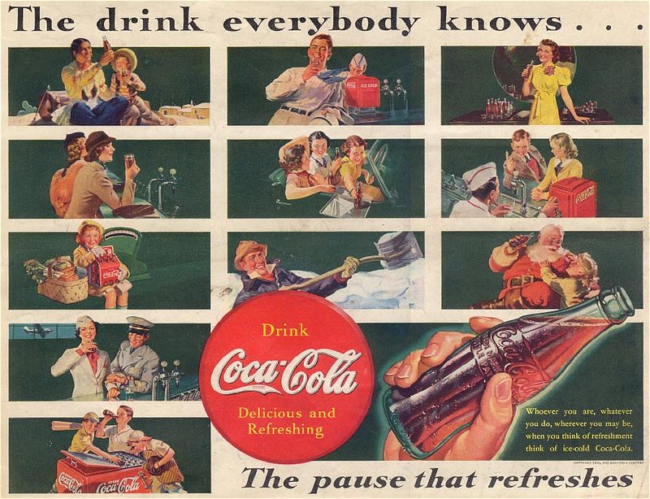
Origination (Creator) vs. Title:
No origination - Enter under title statement
➢ Artificial collections that are known by a particular name
Creator: none [blank]
Title statement: Coca-Cola collection

Slide 41

Origination (Creator) vs. Title:
No origination - Enter under title statement
➢ Personal papers of two or more individuals where no one person is more prominent or predominant
Creator: none [blank]
Title statement: John and Joan Smith papers

Slide 42
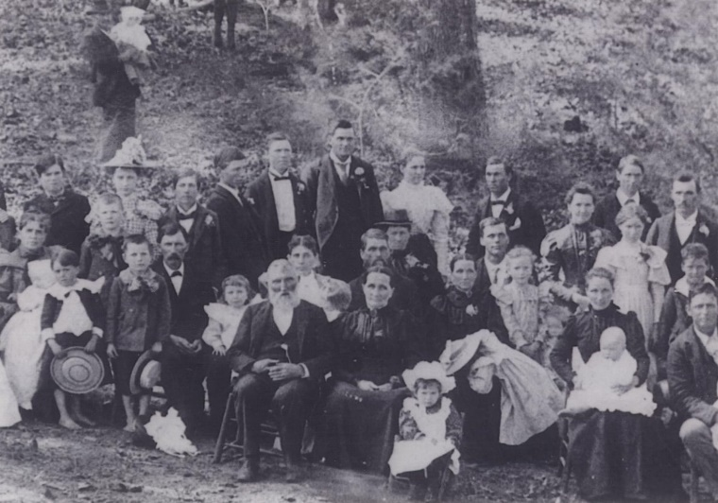
Origination (Creator) vs. Title:
No origination - Enter under title statement
➢ Papers of multiple families
Creator: none [blank]
Title statement: Cobb, Lamar, and Rutherford families papers

Slide 43
Exercise #1
Original (creator) vs Title

Slide 44

Dates and date spans
Inclusive dates:
Georgia Historical Society membership applications, 1888-1900.
Single date:
Cobb’s Legion muster roll, 1863 October 14.

Slide 45
Dates and date spans
Approximate dates:
Friendship Baptist Church (Monticello, Ga.) records, circa 1846-1920
Bulk dates:
Charles L. Gowan family papers, 1846-1966, bulk 1954-1966
Undated:
Hattie Reef diary, undated

Slide 46
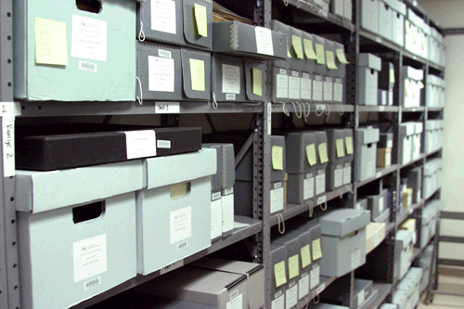
Physical description
Physical description denotes the type(s) of extent associated with the collection.
If the repository holds both the original and a microform copy of the material, the extent is expressed in two separate statements.

Slide 47
Physical description examples
.25 linear feet (1 box)
30 linear feet (43 boxes)
1 item
2 bound volumes
1 microfilm reel ; 35mm.

Slide 48

Language
This element is used to describe the language(s) of the materials being described.
Entire collection in English.
Entire collection in German.
Journals in Italian.
Majority in English, some correspondence in French.

Slide 49
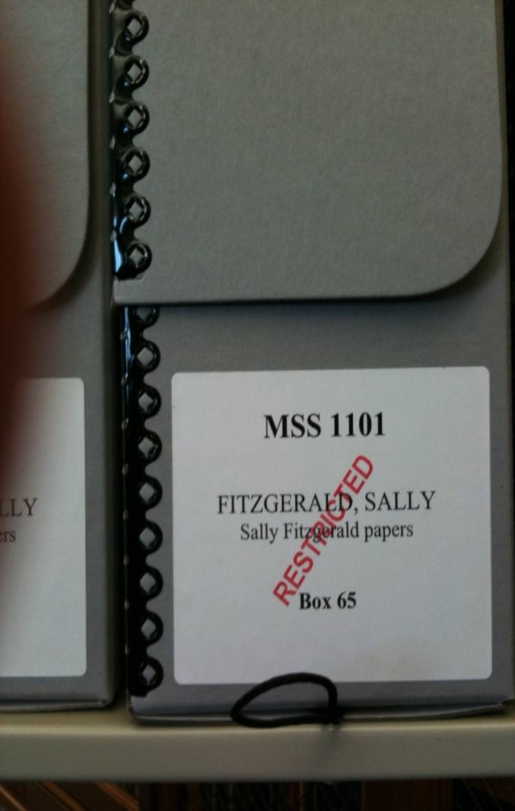
Conditions Governing Access
This element identifies legal or procedural restrictions imposed on individuals wishing to use the collection.

Slide 50
Conditions Governing Access
If unrestricted, state this clearly.
  Unrestricted access.
  No access restrictions.
If restricted by donor, identify the terms and length of the restriction.
  Series 12 is closed to researchers until death of donor.
  Diaries are restricted by donor until May 1, 2021.

Slide 51
Administrative Information

Slide 52
Conditions Governing Access
If restricted by law, identify the statue, law, etc.
  Access to student records is governed by the Family Educational Rights and Privacy Act (FERPA), 20 U.S.C. § 1232g.
Conditions imposed by archives
  Collection is stored off-site. Forty-eight hours advance notice required to access collection.
  Use copies have not been made for all of the audiovisual series at this time. Researchers must contact repository in advance for access to these materials.

Slide 53
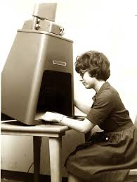
Conditions Governing Use
This element contains information about terms governing the use of materials after access has been provided.
Due to preservation concerns, researchers are required to use the microfilm copy.
Volumes may not be photocopied.
Letters and manuscripts by [name] may not be reproduced without the written permission of [name].

Slide 54
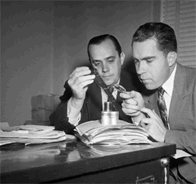
Alternate Form Available
This element is used when the repository possesses both the original records and an additional copy of the records in a different physical format.
Also available on microfiche.
Minutes also available on microfilm.
Typewritten transcripts available in repository.

Slide 55
Location of Originals
This element is used only when the original records are not held by the repository.
Originals at the University of Georgia, Hargrett Library, Athens, Ga.
Originals in possession of donor.
Original diaries in possession of donor, 1989.

Slide 56
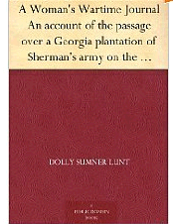
Bibliography
This element contains information about publications by authors who have made major use of the materials described.
Dolly Lunt Burge diary published in: A Woman's War-Time Journal / with introduction and notes by Julian Street. J.W. Burke Co., 1927.

Slide 57
Related Materials
This element contains the location of related materials held in other repositories and identifies specific collection which is related to the materials being described.
Margaret Mitchell papers, Hargrett Library, University of Georgia.
John Kunkel Small collection, Smithsonian Institution, Washington, D.C. and Small family papers, New York Botanical Garden, New York, N.Y.

Slide 58
Separated Material
This element identifies materials that are associated by provenance to the described materials that have been physically separated or removed.
Emory University also holds the private library of Ted Hughes. These items have been cataloged individually. Search for them using the heading Hughes, Ted, former owner.
Photographs contained in this collection have been transferred to the University Photographic Collection.

Slide 59
Acquisition Information
Identifies the immediate source from which the described materials were acquired by the repository
Gift, 1967.
Purchase, 1998, with subsequent additions.
Loaned for microfilming, 1976.

Slide 60
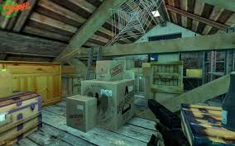
Custodial History
This element can be used to indicate any unusual conditions or developments in the history of the collection.
Originally received as part of the Raoul family papers.
Originally collected by Nathan Brown, then purchased by James Kaplin at auction and donated to the Coastal Historical Society.

Slide 61
Citation Note
This element contains the format for the citation of the described materials that is preferred by the custodian of the record.
[identification of item], Frances F. Pauley papers, Manuscript, Archives, and Rare Book Library, Emory University.

Slide 62
Collection Description

Slide 63
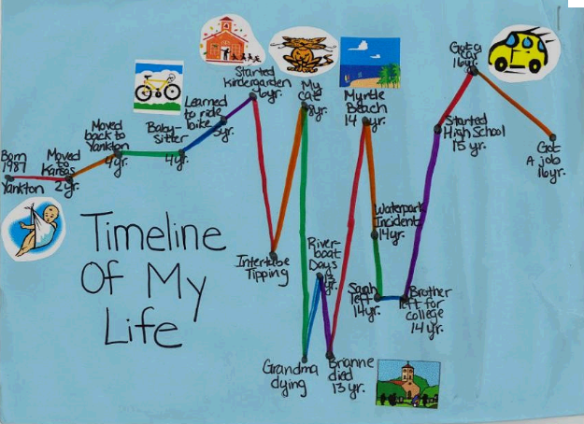
Biographical or Historical Note
The Biographical/ Historical Note contains brief and concise biographical information about an individual or historical information about an organization, institution, or event that has been used as the creator.

Slide 64
Biographical Note
full name, married name, pseudonyms
place and date of birth and death
formal education
place and length of residence
marriage and names of children
occupations or life work
significant accomplishments and achievements
important relationships with other people or organizations
family relationships, if multi-generational

Slide 65
Historical Note
the official name of the organization
organizational name changes
location of the organization
when it was established and dissolved (if applicable)
primary functions
names of the people involved with the organization (if significant)
divisions of the organization (if necessary)

Slide 66

Scope and Content Note
The scope and content note summarizes, in narrative form, the contents of the entire collection.
This note may include an introductory sentence followed by information on types of records, subjects covered, functions documented, major correspondents, and significant people, events, and places discussed.

Slide 67
Scope and Content Note
General introductory sentence
Types of records included
General content
More specific information regarding the contents of particular types of records, both strengths and weaknesses.
Cross references to other parts of the collection

Slide 68
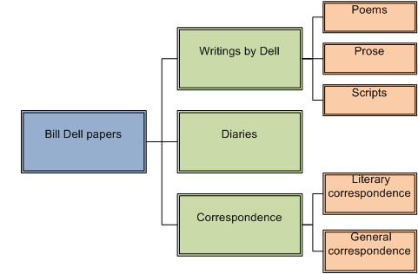
Arrangement
This element describes the manner in which a collection has been subdivided into smaller units such as a collection divided into series/subseries.
Organized into three series:
(1) Writings by Dell, (2) Diaries, and (3) Correspondence.
Organized into three subseries: (1.1) Poems, (1.2) Prose, and (1.3) Scripts.

Slide 69
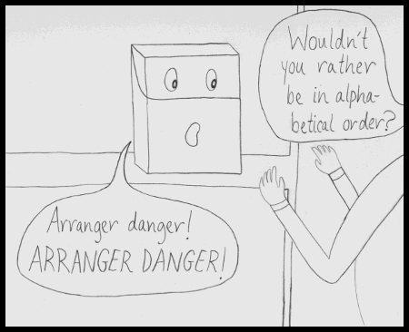
Arrangement
Describes the pattern of arrangement within the collection being described.
Arranged in chronological order.
Arranged in numerical order by case number.
Arranged alphabetically by military unit, and then chronologically.
Derangement and Description webcomic

Slide 70
Other Finding Aid
This element is used to describe any other finding aids to the materials being described.
Name index to selected correspondents available.
Calendar of correspondence available in repository.
Finding aid: http://sage.library.emory.edu.

Slide 71
Exercise #2
Collection-level finding aid

Slide 72
Additions to Living Collections
For a small amount of material
Box Folder Contents
7 10 Correspondence to Betty, 1944
7 10a Correspondence to Betty, 1945
7 11 Correspondence to Betty, February-September 1946

Slide 73
For larger amounts of additional material
Correspondence, 1940-1947
Box Folder Contents
7 9 Correspondence to Betty, 1940-1943
7 10 Correspondence to Betty, 1944
7 11 Correspondence to Betty, February - September 1945
7a 1 Correspondence to Betty, October - December 1945
7a 2 Correspondence to Betty, January - March 1946
7a 3 Correspondence to Betty, April - June 1946
7a 4 Correspondence to Betty, July - December 1946

Slide 74
Correspondence, 1940-1947
Box Folder Contents
7 9 Correspondence to Betty, 1940-1943
7 10 Correspondence to Betty, 1944
7 11 Correspondence to Betty, February - September 1945
21 1 Correspondence to Betty, October - December 1945
21 2 Correspondence to Betty, January - March 1946
21 3 Correspondence to Betty, April - June 1946
21 4 Correspondence to Betty, July - December 1946

Slide 75
Series 12 Additions
Box 21-22
Box Folder Contents
21 Unprocessed additions
22 Unprocessed additions

Slide 76
Exercise #3
Series-level finding aid

Slide 77
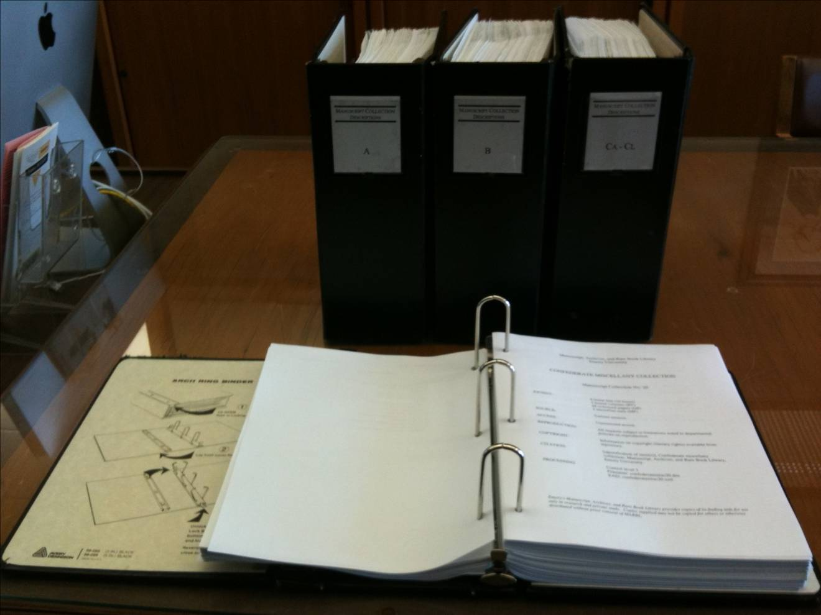
Publishing Finding Aids:
Paper-based in binders

Slide 78
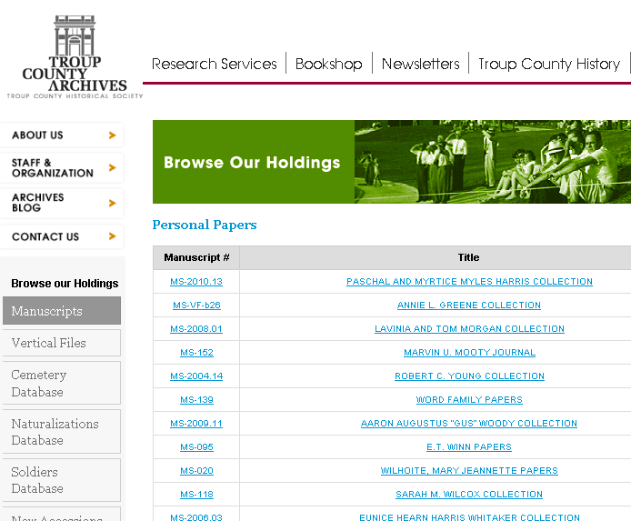
Publishing Finding Aids:
HTML/PDFs

Slide 79
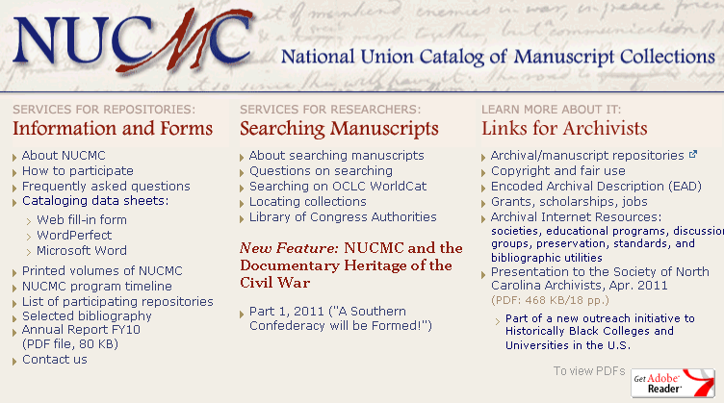
Publishing Finding Aids:
NUCMC

Slide 80



Publishing Finding Aids:
Content Management Systems for Archives

Slide 81
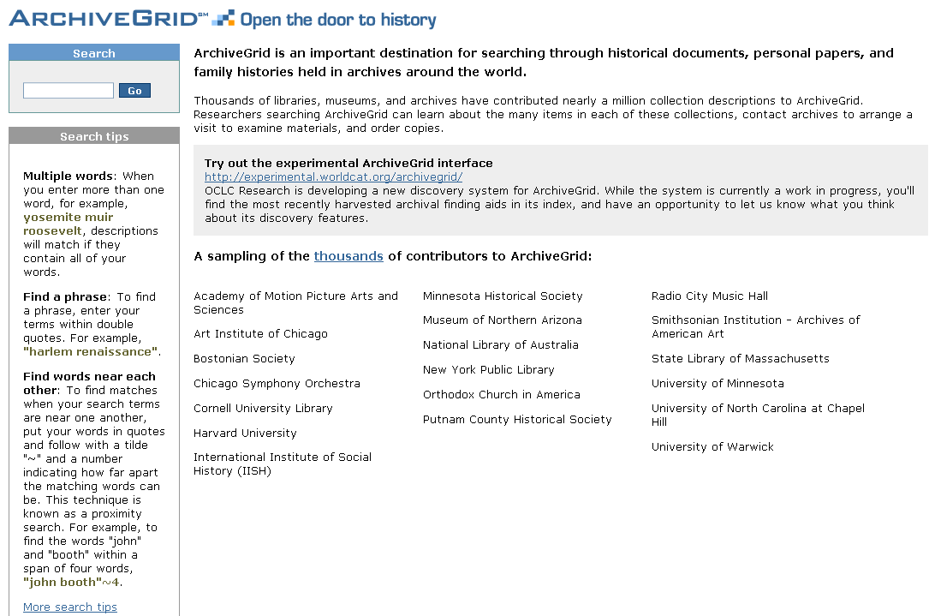
Publishing Finding Aids:
ArchiveGrid

Slide 82
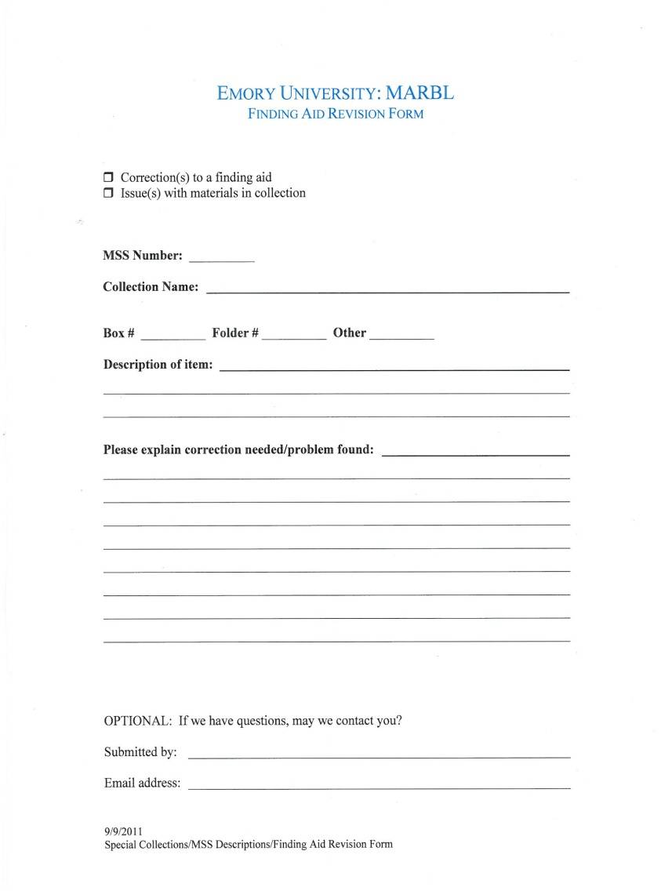
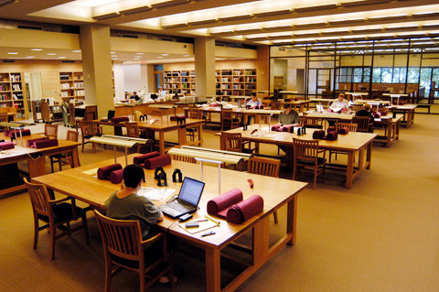
Getting Feedback:
Visiting researchers

Slide 83
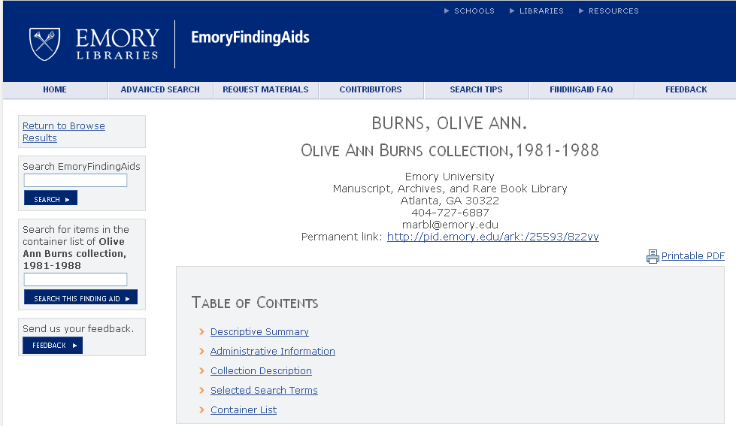
Getting feedback:
Remote researchers

Slide 84
Reappraisal and deaccessioning
To make split collections whole
To correct faulty appraisal at the time of acquisition
To comply with law (replevin)
To assess collecting strengths and collecting focus
To implement a change in a repository's mission
To better balance research potential of collections with the necessary allocation of resources for their care and preservation

Slide 85
Reappraisal and deaccessioning
process should be systematic
process should be transparent
process should be thoroughly documented
implemented across the full range of an institution's holdings or applied only to individual collections
applicable to an entire collection or a portion of a collection
there are legal and ethical considerations
plan for the future now

Slide 86

Administration of Processing
Procedure manuals
Accession reports
Yearly processing action plans
Processing reports
Collection use statistics

Slide 87

Questions?

